Slide 1
Administering SQL Server 2012/2014
Ajay Dwivedi | Senior SQL DBA | SQL Trainer

Slide 2

Meet Ajay Dwivedi
Senior SQL DBA – TiVo
Handle Instance and Database Maintenance
MCP since June 2014
Handle Performance Tuning, and other Troubleshooting tasks of 4.5k servers
Saved millions through Automation for Organization
Expert in Querying, Administration, and Performance Tuning
Worked as DBA, Database Developer, and Migration Developer in various organizations.
Trainer of Ajay Dwivedi’s SQL Server Classes

Slide 3
Course Topics
Administering SQL Server 2012/2014
01 | Planning & Installing SQL Server | 09 | Replication
02 | Configuring and Managing Instances | 10 | SQL Cluster
03 | Configuring SQL Server Components | 11 | AlwaysOn Availability Group
04 | Migrating, Importing and Exporting | 12 | SQL Cluster
05 | Logins, Roles, and Users | 13 | AlwaysOn Availability Group
06 | Securing SQL Server | 14 | Troubleshooting SQL Server
07 | Log Shipping | 15 | Indexes and Concurrency
08 | Mirroring | 16 | SQL Agent, Backup, and Restore

Slide 4
Chapter 01 – Planning & Installing SQL Server
Lesson 01 | Planning Your Installation
Gathering Installation Requirement
Designing the Installation
Planning Scale Up versus Scale Out
Designing the Storage for New Databases
Identifying a Standby Database for Reporting
Identifying Windows-Level Security and Service-Level Security
Performing a Core Mode Installation

Slide 5
Chapter 01 – Planning & Installing SQL Server
Lesson 02 | Installing SQL Server and Related Services
Configuring an Operating System Disk
Installing the SQL Server Database Engine
Installing SQL Server 2012 from the Command Prompt
Installing SQL Server Integration Services
Enabling and Disabling Features
Installing SQL Server 2012 by Using a Configuration File
Post-Installation Steps
Testing Connectivity

Slide 6
Topic: Installation Decisions

Slide 7


Topic: Installation Decisions
Determine the Appropriate Hardware
Select the Appropriate Windows Operating System Edition
Select the Appropriate Edition of SQL Server
Determine if a Separate Instance Is Required
Select the Appropriate Collation

Slide 8
Determine the Appropriate Hardware
To virtualize or not to virtualize?
CPU sockets and cores
Memory
Memory support is a function of the Windows operating system or the chosen edition
DAS versus SAN
Consider solid state storage
Free, unsupported tools are available to help test I/O workloads:
SQLIO “disk subsystem benchmark tool”
SQLIOSIM

Slide 9
Select the Appropriate Windows Operating System Edition
Specific editions of SQL Server are supported on specific versions and editions of Windows Client and Windows Server
One way or another, the following operating systems are supported:
Windows Server 2012
Windows Server 2008 R2 and Windows Server 2008 SP2
Windows Vista, Windows 7, and Windows 8
SQL Server 2012 is supported on Windows Server 2012 core and Windows Server 2008 R2 core
No need to memorize all the combinations for the certification exam

Slide 10
Select the Appropriate Edition of SQL Server 2012
Editions to choose from are:
Principal Editions
Enterprise
Business Intelligence
Standard
Evaluation
Specialized Edition(s)
Web
Breadth Editions
Express
Developer

Slide 11
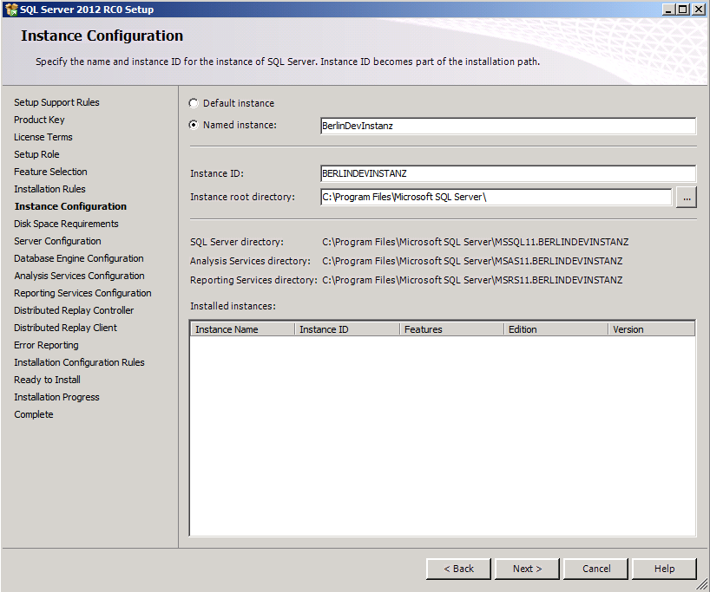
Determine if a Separate Instance Is Required
Each instance will have its own set of services and service settings
Separate administration requirements
Separate instance-level configuration settings
Separate SLAs
Support for separate collations
Support for multiple versions of SQL Server
Know which features can be installed as instances

Slide 12
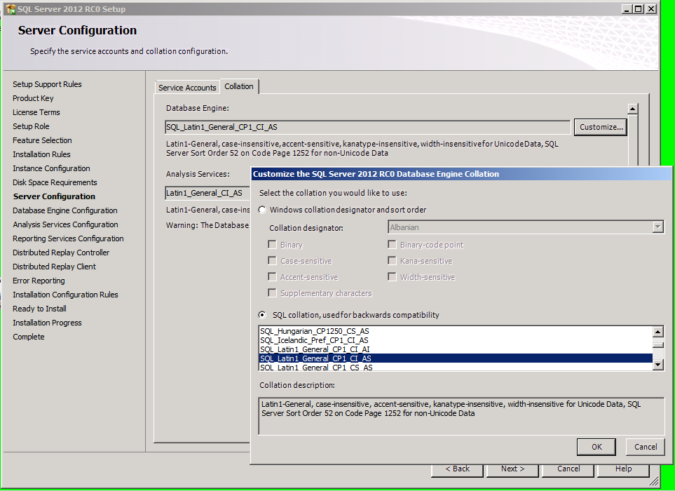
Select the Appropriate Collation
What is a collation?
What is the impact of collation choice during installation?
Where can collation be specified?

Slide 13
Specifying Collation at the Instance, Database, Column and Query Levels

Slide 14
Topic: Design the Storage for New Databases

Slide 15
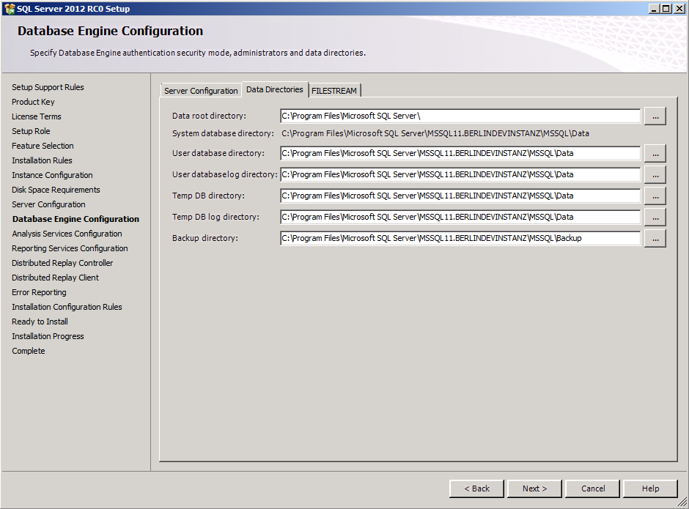
Topic: Design the Storage for New Databases
Drive Layout: Design Windows File System for Expected I/O Patterns
Consider Multiple Filegroup and Multiple Data File Designs
Table Partitioning Design

Slide 16
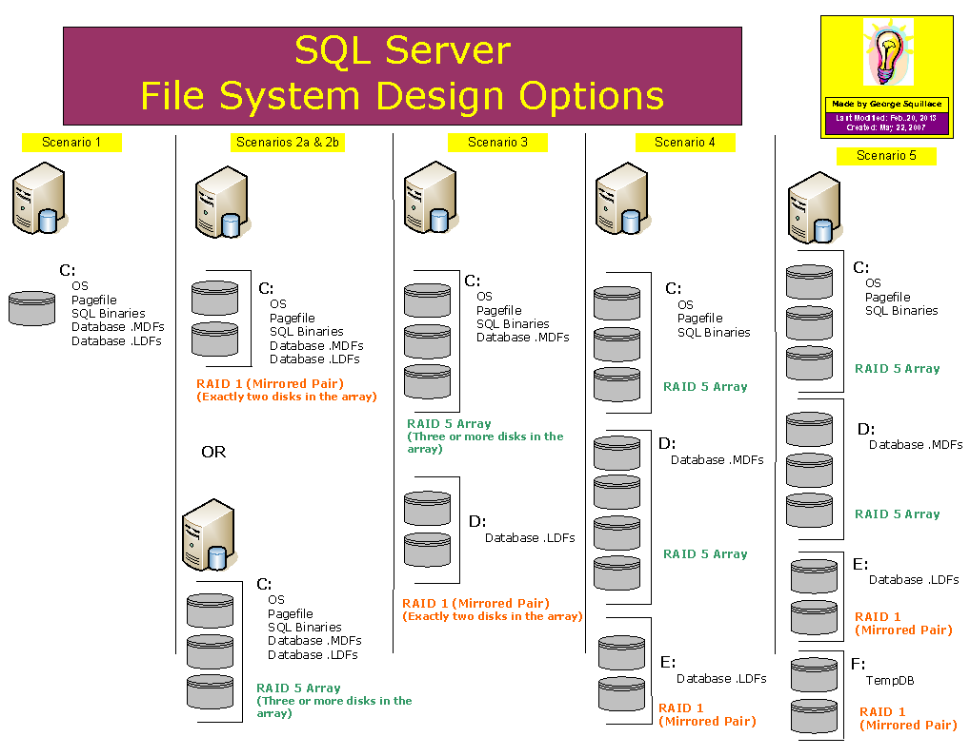
Drive Layout: Design Windows File System for Expected I/O Patterns
Separate I/O activity on systems with heavy workloads:
OS vs. data file(s) vs. log file
Consider separating TempDB workload
Consider adding multiple data files to TempDB
Use appropriate RAID levels and parity when appropriate
Consider adding multiple data files to TempDB for large workloads

Slide 17
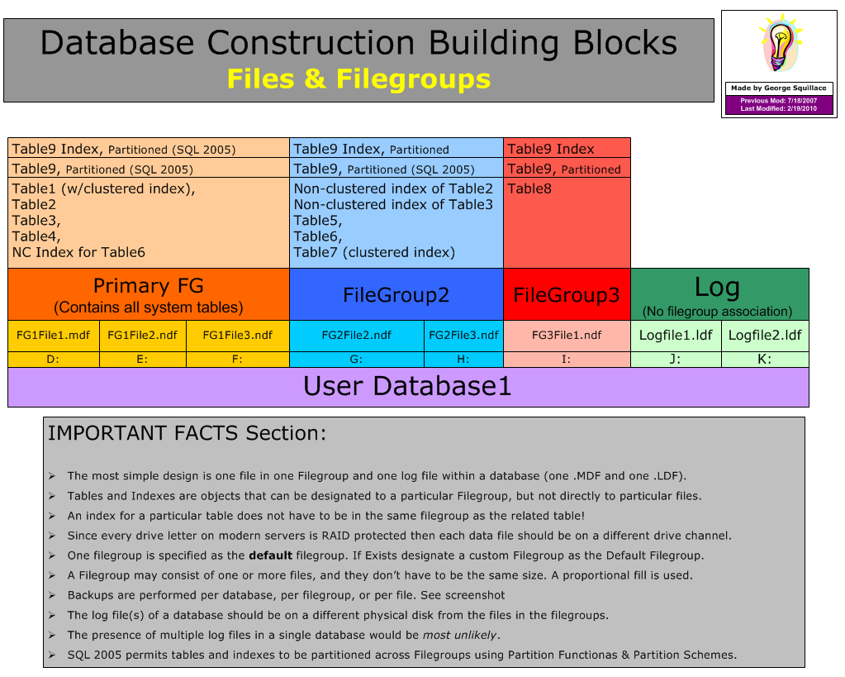
Consider Multiple Filegroup and Multiple Data File Designs
Use this advanced design technique for two reasons:
Performance
More read/write heads involved in reading and writing
Maintenance
Smaller units of data backed up/restored, indexes reorganized/rebuilt

Slide 18
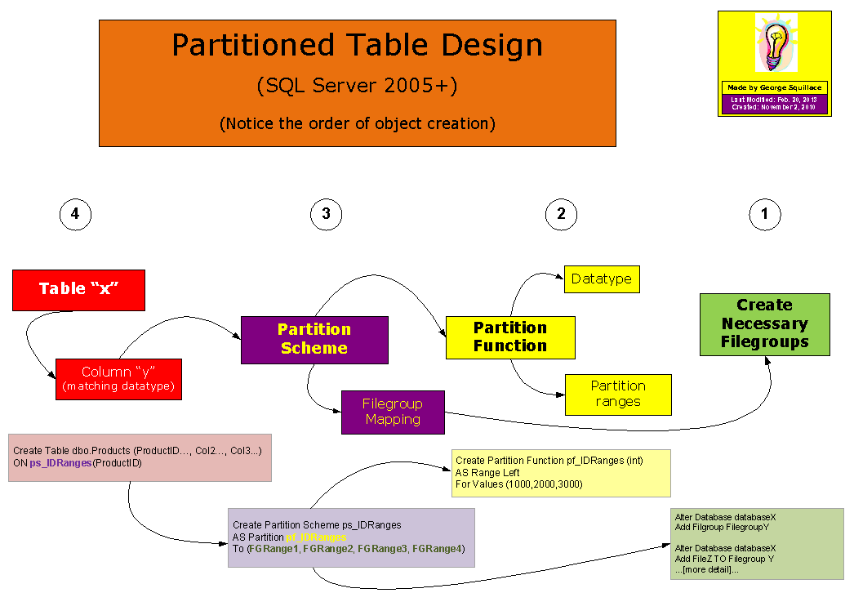
Table Partitioning Design
Table partitioning spreads the data of a single table over multiple filegroups
Purpose
Use more read/write heads to separate I/O activity over separate partitions
Efficiently load new data into a (large) table
Perform index maintenance on a partition by partition basis
Concept of index “alignment”
References
Designing Partitions to Manage Subsets of Data
SlidingWindow example

Slide 19
Creating a Database with an Advanced Design

Slide 20
Topic: Plan for Growth and Capacity

Slide 21
Topic: Plan for Growth and Capacity
Two DBA Cardinal Sins
Manual File Growth
File Autogrow Options
Growth Monitoring
Shrinking Databases and Files

Slide 22
Two DBA Cardinal Sins
Running out of space in a SQL Server data or log file
Allowing a data or log file to fill up a volume when autogrow is used

Slide 23
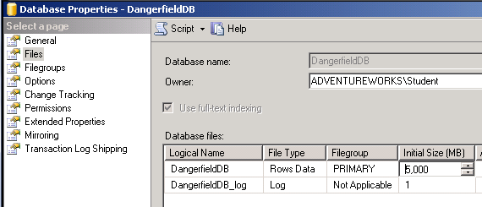
Manual File Growth
Why manual?
Timing and control
Methods
GUI
Code

Slide 24
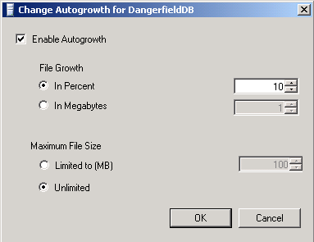
File Autogrow Options
Why autogrow?
Percent vs. fixed size
Should “maximum file size” be set?
Methods
GUI
Code

Slide 25
Growth Monitoring
If/when to shrink or grow
Monitoring tools and techniques
Code in agent jobs
Performance object alert
Management Data Warehouse
Catalogs and DMVs
sys.database_files
sys.dm_os_volume_stats
Stored procedures
sp_SpaceUsed
sp_Databases
DBCC SQLPerf (logspace)

Slide 26
Shrinking Databases and Files
Databases (all files) can be shrunk
Individual data and log files can be shrunk
Autoshrink can be set as a database option
Just say “No”
Turned off by default
Manual shrinking only relevant in one context

Slide 27
Growing File Size Manually Using the GUI and Code

Slide 28
Topic: Service Account Configuration

Slide 29
Topic: Service Account Configuration
Account Selection During Installation
Changing Account Choices After Installation
Which tool? Why that tool?
On What Basis Do I Select Accounts to Run Services?

Slide 30
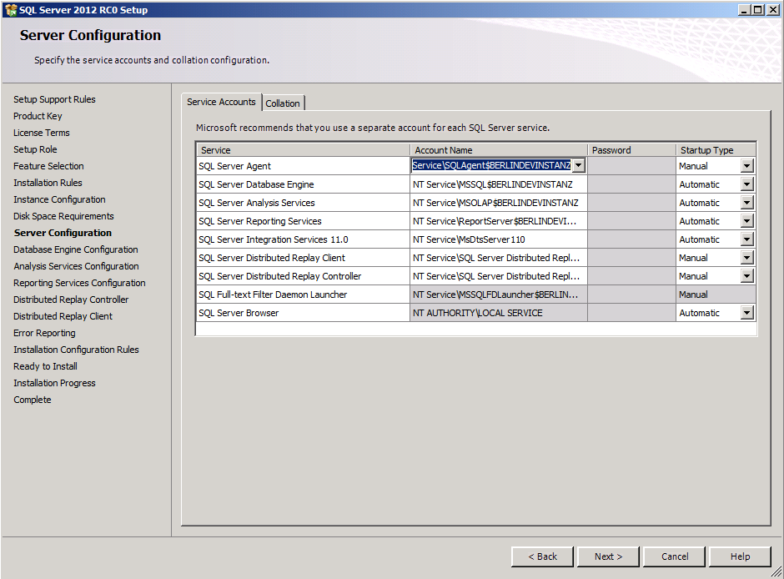
Account Selection During Installation
Builtin Account
Local Service
Network Service
Local System
Created Account
Machine Local
Domain
General rule: create a separate account for each service, for each instance…really!

Slide 31
Changing Account Choices After Installation
Use SQL Server Configuration Manager
Don’t use the Services management console in Windows

Slide 32
On What Basis Do I Select Accounts to Run Services?
Database engine can use a low-privileged account
Browser and Full-Text Services shouldn’t require a domain account either
SQL Server Agent may need access to:
Mailbox
UNC shares and file systems
Other SQL Servers
Reference: Configure Windows Service Accounts and Permissions

Slide 33
Changing Service Account Assignment

